Slide 3
Electricity is Life! By Ngalula Sandrine Mubenga, PE, MSEE CEO SMIN Power Group
Midwest Renewable Energy Association
27th Annual Energy Fair
Custer, Wisconsin-USA 06/18/2018

Slide 4
Agenda
Motivation for solar power
Developing the fuel cell car and solar H2 station
Designing +24MW of solar in the USA
Advocating for solar (COP21,EU parliament, ICRERA)
SMIN Power Group providing solar in D.R.Congo (Africa)
What can you do to advance solar power globally?

Slide 5
First, Let’s Play A Game!

Slide 6
i.Around the world in 180sec
Where is this?

Slide 7
ii. Around the world in 180sec
Where is this?

Slide 8
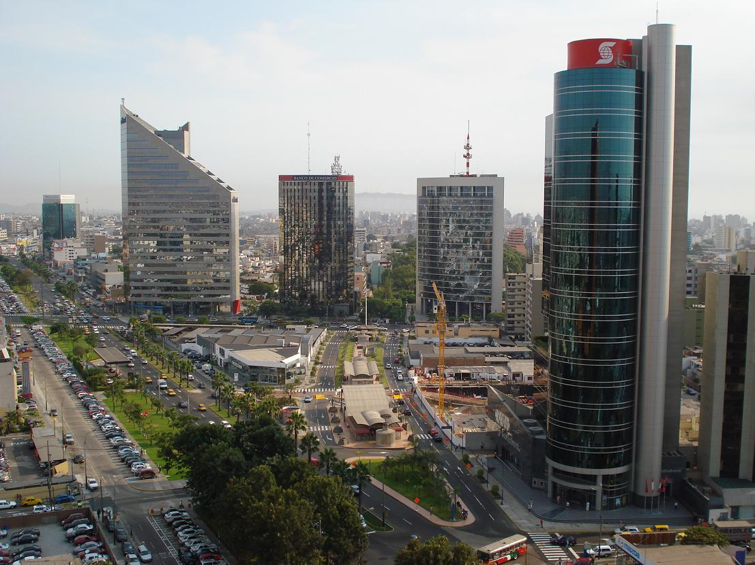
iii. Around the world in 180sec
Where is this?

Slide 9
Now… Let’s Talk About Green, Renewable, and Solar Energy

Slide 10
1. Motivation- What lit the fire in me?
No electricity + No fuel + Need ER surgery
3 days between life and death
$$∴Electricity is life!$$
1.Dedicated my life to find solutions to the immeasurable power problems ravaging Africa.
2.Decided to study BS, MS, and Phd in Electrical Engineering at the University of Toledo, Ohio.

Slide 11
Why renewable energy (RE) solution?
Solution= clean x renewable x easy to deploy= Solar
RE uses natural resources (Sun, wind, rivers) which are less polluting for the planet. RE helps combat climate change.
RE helps preserve the planet for our children and future generations.
Energy is the challenge of the 21st century for communities around the world.
To be an active member of the global community that finds solutions to the energy challenge.

Slide 12
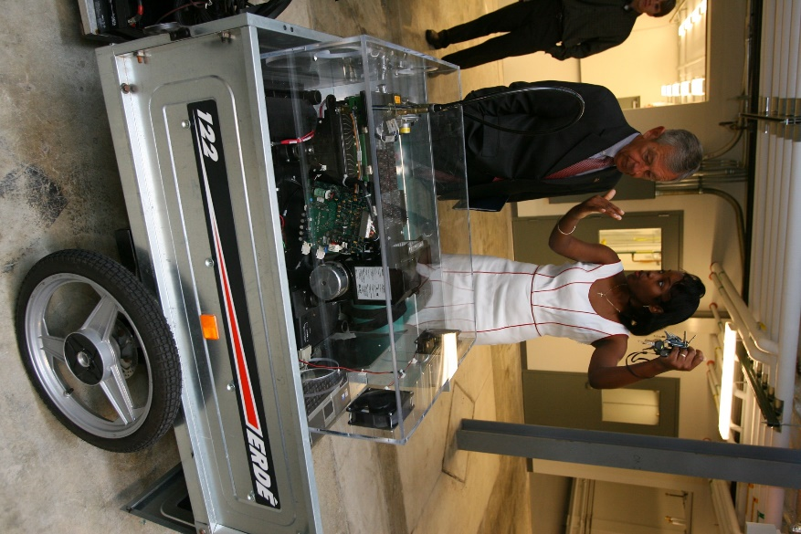
2.Developing fuel cell car and solar H2 station
Purpose:
Demonstrate the technical feasibility of FCHV transportation using hydrogen that is produced primarily by solar energy
Electric vehicles (EVs) have emerged as am alternative to internal combustion engines because they do not emit carbon dioxide.
Drawbacks: limited driving range & and long time needed to charge the battery bank.
Solution: Integrate a fuel cell (FC) with the battery. Like EVs, fuel cell hybrid vehicles (FCHVs) produce no pollutants during operation.

Slide 13
Fuel Cell Hybrid System

Slide 14
FC and Battery Currents vs. Battery (Load) Voltage

Slide 15
Solar Powered Electrolyzer System & Fueling Station

Slide 16
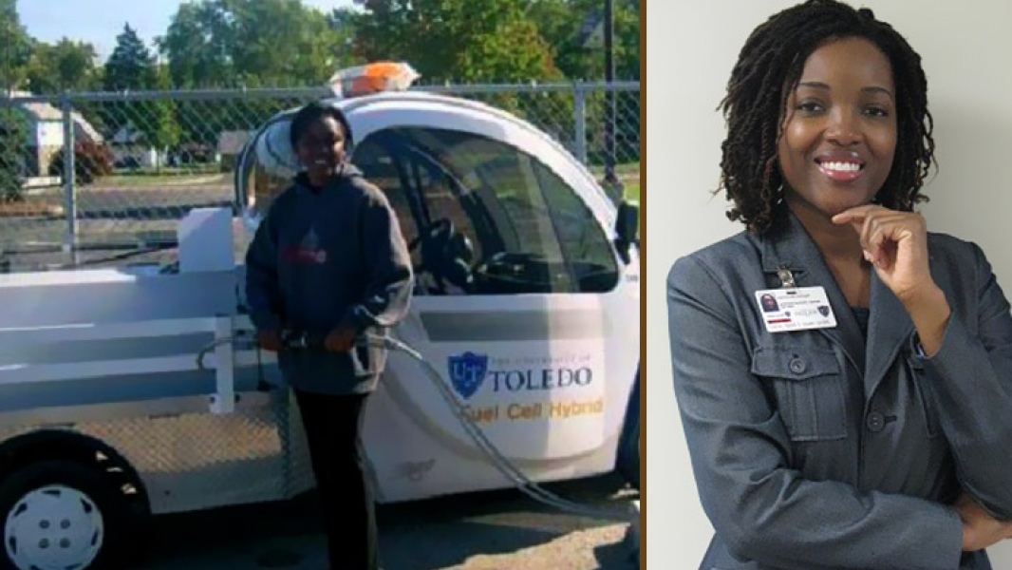
Hydrogen Generating and Fueling Station

Slide 17
3. Designing/Interconnecting +50MW of solar PV in the USA
Napoleon, OH :4.2 MW, 3Ph, 12.470 KV,( 17,140) mono
Linkwood, MD: 20MW, 3Ph, 69KV, (16,224) mono
Lodi, OH: 20MW, 3Ph, 69KV, (16,224) mono
Greenville, OH: 4MW, 3Ph, 12.470KV, (16,224) 250 mono
Findlay, OH: 2MW, 3Ph, 12.470KV, (8,064) mono
Toledo, OH: 20KW multiple locations

Slide 18
4. Advocating for solar (COP21, EU Parliament, ICRERA)
Nov 25, 2015
IEEE International Conference on Renewable Energy Research and Applications (ICRERA), Italy:
Invited as guest speaker to present peer reviewed research on “Grid-tied Solar PV for Island States: challenges, opportunities and waste management”.
52 countries participating.
4 universities from the USA.

Slide 19
Advocating for solar
Nov 30, 2015
European Parliament, Belgium
Invited as panelist during S&D Africa Week to showcase solar work SMIN Power Group is doing in Africa
Multiple countries participating.
Postponed due to terrorist attack

Slide 20
Advocating for solar
Dec 1, 2015
COP21 News by France24 news channel:
Invited as guest to comment on renewable energy for Africa during COP21 Africa Summit.
See Video http://www.sminpowergroup.com/resources/media/

Slide 21
4.SMIN Power Group Delivering solar power in Africa
Sandrine Mubenga, PE, MSEE is Founder and President of SMIN Power Group.
SMIN Power Group, SARL is a Congolese company with subsidiary in the USA.
Objective: To provide affordable electricity for communities using renewable energies, from design to installation.
Mission: To offer services and products that are clean, sustainable and promote the local economy, while also educating the customer.

Slide 22
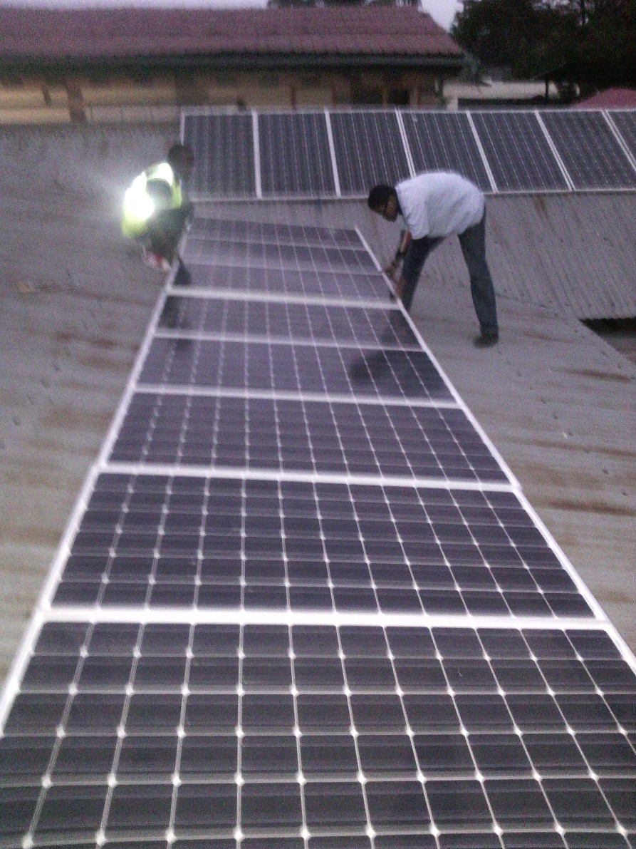
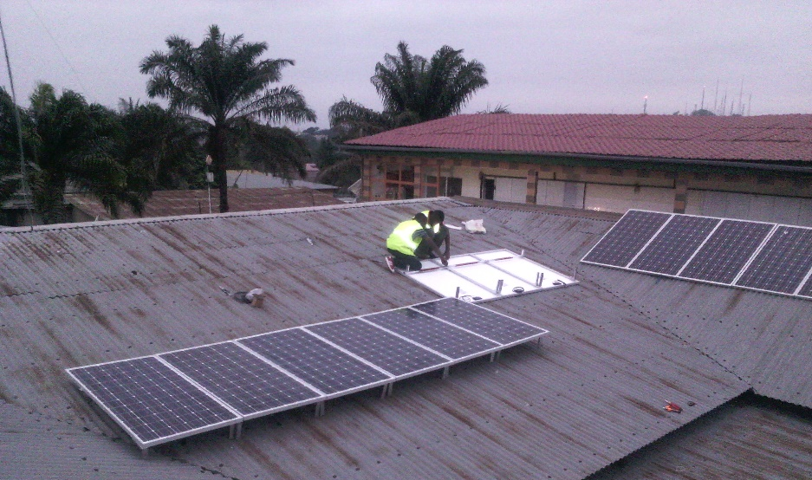
SMIN Power Group in D.R.Congo

Slide 23
Solar Energy Installation
Type: Grid Connected Rooftop + Storage
Location: Kinshasa, D.R.Congo
Energy : 100,000 Wh/day
Payback: 8,2 years
Cost Savings: 17% over system life
GHG avoidance: 629 MT= 132 cars off the road
Avoided CO2 of 70,802 gallons of gasoline

Slide 24
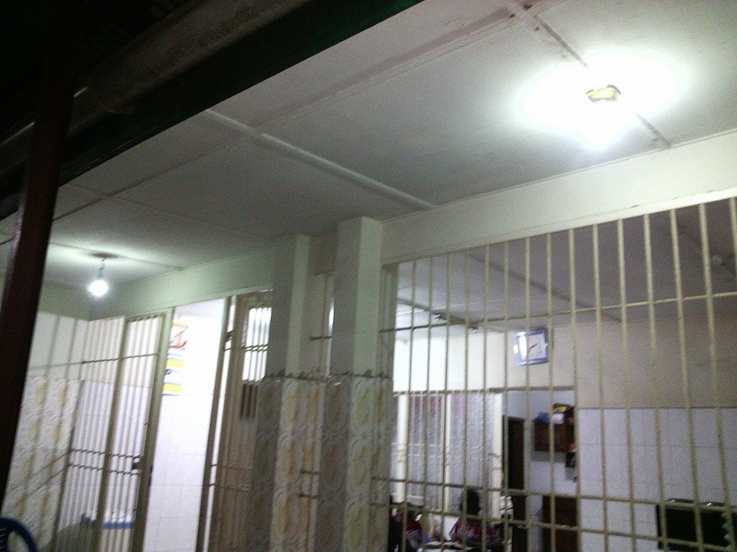
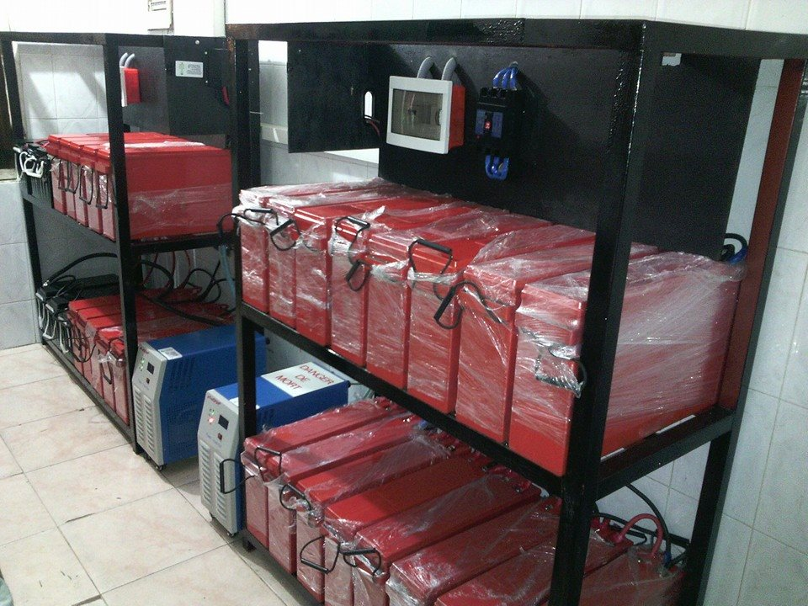
SMIN Power Group in DRC

Slide 25
Solar energy feasibility study
Solution: Feasability Study of Stand Alone PV System
Location: Kikwit, D.R.Congo
Size: 9,000 Wp solar PV array +
Impact: 600 students per year.
Payback: 9,5 years
Energy Cost Savings: 30% over system life
GHG avoidance: 269 MT= 56.9 cars off the road
Avoided CO2 of 30,307 gallons of gasoline

Slide 26
5. What can you do to advance solar globally?
Learn: Stay in school, advance in your studies.
Connect: Join an organization to advance solar.
Act: Get your hands dirty, experiment with RE.
Share your knowledge, inspire others.
Remember: We are all citizens of this world.

Slide 27
Electricity for Peace
For the past 20 years, DRC has been torn with various armed conflicts wich killed over 3 millions poeple, displaced over 3.5 millions congolese. Women have been extremelly victimised because rape was used as a tactic of war.
Indeed, the United Nations has estimated that over 500,000 Congolese women have been raped since the beginning of these conflicts. Nowadays, women in Eastern Congo are still victims of these rapes.All they want is Peace and Justice.
In order to achieve peace, multiple factors come into play. Electricity is one of the greatest tool to achieve peace and help restaure a sense of safety and well being in these communities. 91% of the population in the DRC needs access to electricity according to the SNEL 2013 report. Electricity is a huge market.
Our solution: « Electricity for Peace »

Slide 28
Why focus on D.R.Congo?
DRCongo contains 98% of the world reserve of Coltan, a mineral that is used to make cellphone, laptop etc.
For the past 20 years, DRC has been torn with various armed conflicts wich killed over 3 millions people, displaced over 3.5 millions congolese. Women have been extremelly victimised because rape was used as a tactic of war. These war allow the illegal mining of Coltan.
Indeed, the United Nations has estimated that over 500,000 Congolese women have been raped since the beginning of these conflicts. Nowadays, women in Eastern Congo are still victims of these rapes. All they want is Peace and Justice.
In order to achieve peace, multiple factors come into play. Electricity is one of the greatest tool to achieve peace and help restaure a sense of safety and well being in these communities. 91% of the population in the DRC needs access to electricity according to the SNEL 2013 report. Electricity is a huge market.

Slide 30
Powering Your Life with Green Solutions.
www.SminPowerGroup.com

